Slide 1


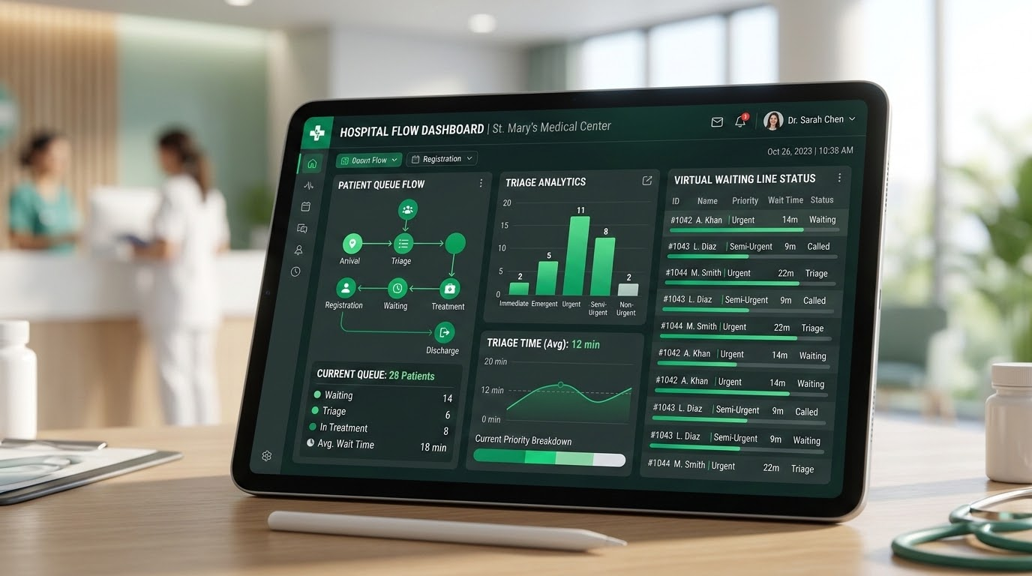
PRASANNA SCHOOL OF PUBLIC HEALTH | MAHE
SVASTH 26
Department of Healthcare and Hospital Management
SVASTH IDEATHON - 2026
Dynamic OPD Queue & Triage Tracker
Decentralized Virtual Waiting Lines & Real-Time Patient Flow Optimization
PROBLEM STATEMENT TITLE
TEAM INFORMATION
Mitigating Severe OPD Waiting Congestion via Smart Real-Time Routing
Team Name: Obsidian Loop
Leader: Abhay Raj Singh
Member 1: Krishna Sahu
Member 2: Arohi Srivastava

Slide 2





CLINICAL BOTTLENECKS & FRICTION
Problem Statements
3 to 5 Hours
Average blind waiting time for Indian hospital OPD consultations
Dangerous Corridor Overcrowding
High airborne cross-infection risk in stagnant waiting areas.
Zero Operational Visibility
Static tokens fail when emergency consultations cause delays.
Severe Administrative Burnout
Nursing staff overwhelmed fielding repetitive status inquiries.

Slide 3







SYSTEM ARCHITECTURE & WORKFLOW
Technical Approach
1. Zero-App Check-In
2. Dynamic ETA Engine
3. Proximity Broadcast
4. 1-Tap Doctor Portal
Instant token generation via QR scan or receptionist entry.
Calculates wait times using real-time doctor pace algorithms.
Automated WhatsApp and SMS pings dispatched 2 turns prior.
Single-click patient advancement with instant emergency hold.
Modern Tech Stack:
Frontend: Next.js • Real-Time Sync: Node.js WebSockets • Alerts: WhatsApp Cloud API

Slide 4
DEPLOYMENT & OPERATIONAL FIT
Feasibility And Viability
Technical Viability
Operational Viability
Economic Viability
Zero Hardware Overhaul: Runs smoothly on standard clinic tablets.
10-Minute Training: Intuitive interfaces require zero specialized training.
SaaS Cost Model: Negligible per-hospital cloud subscription fees.
Low Bandwidth Sync: Operates seamlessly under unstable 3G/4G connections.
Elderly Inclusive: Physical paper receipts for non-smartphone patients.
3-Week Pilot: Rapid sandbox rollout in outpatient departments.
Triage Protocol: Fast priority overrides for critical walk-ins.
High ROI: Minimizes staff attrition and elevates patient throughput.

Slide 5




MEASURABLE OUTCOMES & PUBLIC HEALTH VALUE
Impact And Benefits
-65%
40 Min
92%
Corridor Crowd Density
Saved In Clinical Waiting Areas
Patient Satisfaction Rating
Patients & Families
Clinical Staff
Hospital Administration
Freedom to wait in open cafeterias; reduced hospital infection exposure.
Orderly consultation rooms; zero repetitive queue-inquiry interruptions.
Actionable throughput analytics; optimized departmental resource allocation.

Slide 6
ACADEMIC LITERATURE & FRAMEWORKS
References
All India Institute of Medical Sciences (AIIMS) & BMJ: Time-motion transit evaluations in public tertiary outpatient departments across Northern India (2020–2024).
National Health Authority (NHA), India: Ayushman Bharat Digital Mission (ABDM) guidelines for digital queue management and outpatient registration integration.
Journal of Healthcare & Hospital Management: Application of M/M/c queueing theory models to decongest multidisciplinary outpatient clinics.
World Health Organization (WHO): Core standards for Infection Prevention and Control (IPC) in high-volume outpatient healthcare settings.
Thank You • Open for Discussion & Q&A

